Slide 1

Chapter 21
Network Layer:
Address Mapping,
Error Reporting,
and Multicasting
21.<number>
Copyright © The McGraw-Hill Companies, Inc. Permission required for reproduction or display.

Slide 2
21-1 ADDRESS MAPPING
The delivery of a packet to a host or a router requires two levels of addressing: logical and physical. We need to be able to map a logical address to its corresponding
physical address and vice versa. This can be done by using either static or dynamic mapping.
Topics discussed in this section:
Mapping Logical to Physical Address
Mapping Physical to Logical Address
21.<number>

Slide 3
ARP: Address Resolution Protocol logical to physical address
Logical address for a given URL(Uniform Resource Locator) can be obtained by DNS (Domain Name System)
The MAC layer needs physical address.
ARP helps to obtains physical address.
21.<number>

Slide 4

Figure 21.1 ARP operation
21.<number>

Slide 5

Figure 21.2 ARP packet
Hardware type: Ethernet 1
Protocol type: IPV4 -> 0x0800
Hardware length: length of physical address : for Ethernet =6
Protocol length: length of logical address ipv4=4
21.<number>

Slide 6
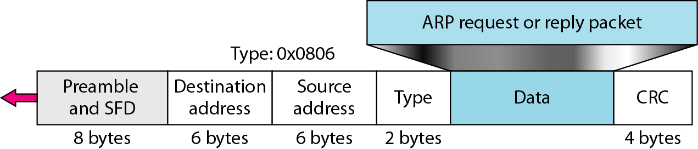
Figure 21.3 Encapsulation of ARP packet
21.<number>

Slide 7

Figure 21.4 Four cases using ARP
21.<number>

Slide 8

Note
An ARP request is broadcast;
an ARP reply is unicast.
21.<number>

Slide 9
Example 21.1
A host with IP address 130.23.43.20 and physical address B2:34:55:10:22:10 has a packet to send to another host with IP address 130.23.43.25 and physical address A4:6E:F4:59:83:AB. The two hosts are on the same Ethernet network. Show the ARP request and reply packets encapsulated in Ethernet frames.
Solution
Figure 21.5 shows the ARP request and reply packets. Note that the ARP data field in this case is 28 bytes, and that the individual addresses do not fit in the 4-byte boundary. That is why we do not show the regular 4-byte boundaries for these addresses.
21.<number>

Slide 10

Figure 21.5 Example 21.1, an ARP request and reply
21.<number>

Slide 11

Figure 21.6 Proxy ARP
21.<number>

Slide 12

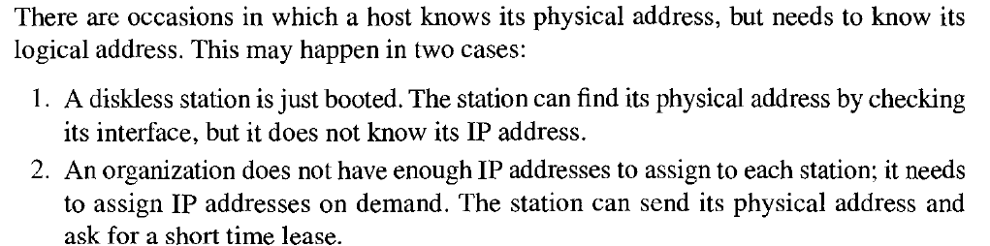
Mapping physical to logical address:
RARP, BOOTP, DHCP
21.<number>

Slide 13
BOOTP: Bootstrap Protocol
Client server protocol to provide physical address to logical address mapping.
It is an application level protocol
UDP is used to send details and its encapsulated in an IP packet.
All 0’s and all 1’s as address in IP packet
The relay agent forwards the packet to BOOTP server
21.<number>

Slide 14
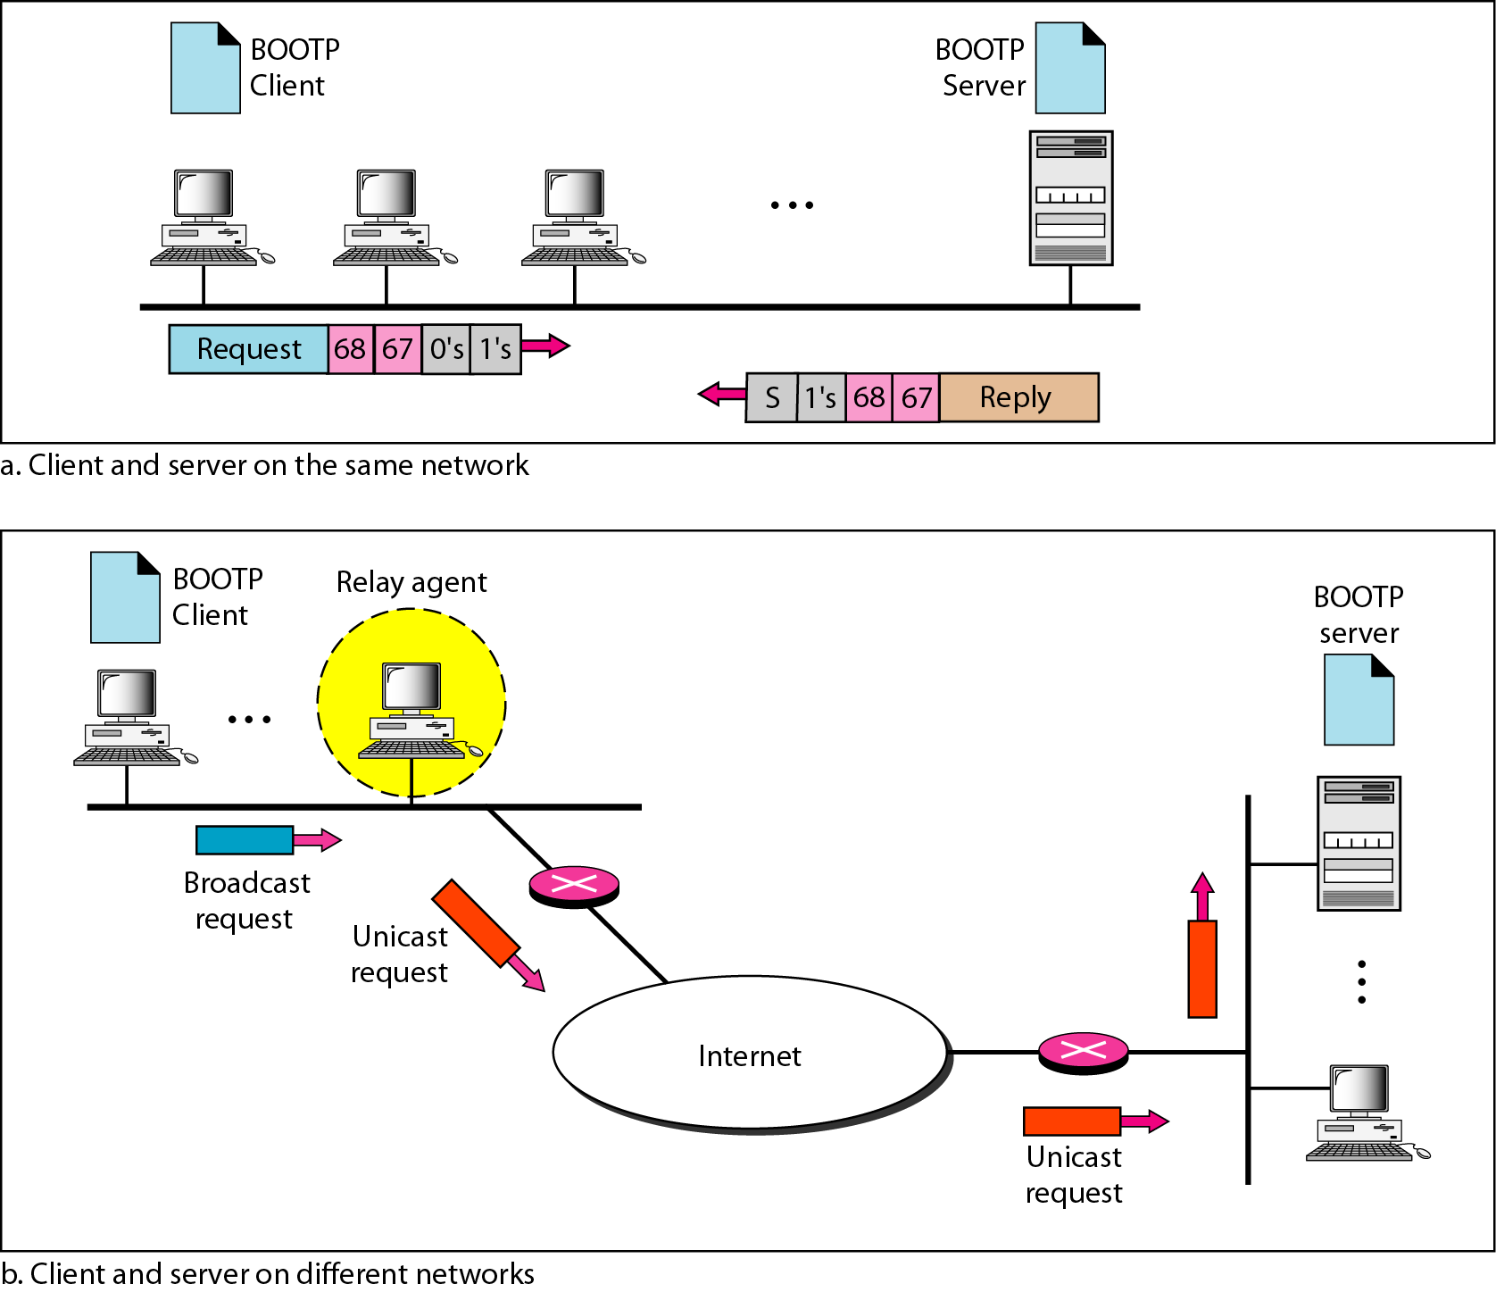
Figure 21.7 BOOTP client and server on the same and different networks
21.<number>

Slide 15
RARP: Reverse address resolution protocol:
When the system needs to know about its logical address, it gets its physical address, and sends RARP. The nodes runs RARP client and the RARP server responds with logical address.
Broadcast is in data link layer specifying destination address as all 1’s. RARP packet cannot get forwarded in other networks. (only same network)
21.<number>

Slide 16
DHCP: Dynamic host configuration protocol
Static address allocation: Similar to BOOTP
Dynamic address allocation:
  DHCP client request for the address
  DHCP server checks static database. If an entry is present , return static address.
  If no entry in static database, then selects address from a pool and returns it.
  The DHCP assigns the address on basis of lease for specific interval of time.
21.<number>

Slide 17
Note
DHCP provides static and dynamic address allocation that can be
manual or automatic.
21.<number>

Slide 18
21-2 ICMP
The IP protocol has no error-reporting or error-correcting mechanism. The IP protocol also lacks a mechanism for host and management queries. The Internet Control Message Protocol (ICMP) has been designed to compensate for the above two deficiencies. It is a companion to the IP protocol.
Topics discussed in this section:
Types of Messages
Message Format
Error Reporting and Query
Debugging Tools
21.<number>

Slide 19

Figure 21.8 General format of ICMP messages
21.<number>

Slide 20
Note
ICMP always reports error messages to the original source.
21.<number>

Slide 21
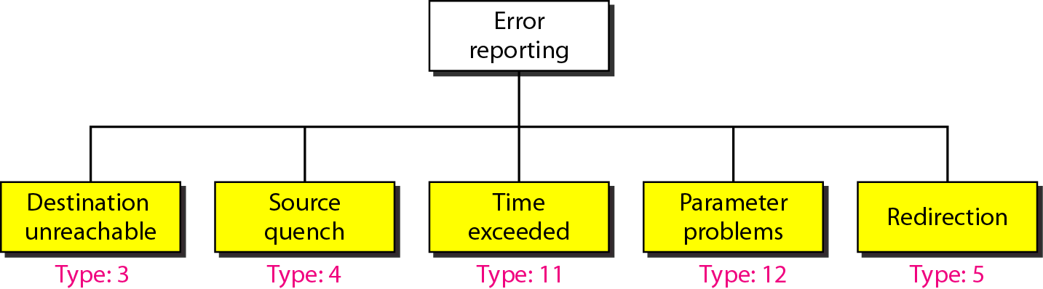
Figure 21.9 Error-reporting messages
21.<number>

Slide 22
Error Reporting
Destination unreachable: by host or router
Source quench:
  IP layer does not have any flow control.
  The source may be sending packets faster than the router can handle.
  So source quench indicates the source should slow down as there is congestion at some point in network.
21.<number>

Slide 23
Error Reporting
Time exceeded :
  When the router decrements TTL and if it becomes zero, discard the packet and inform source regarding same by mentioning Time exceed.
  If all fragments are not reached the destination, then destination generates fragments.
Parameter problem:
  If any router or destination host identifies any parameter in header is not correct, then generates ICMP packet
21.<number>

Slide 24
Error Reporting
Redirection
  The host and router mentions next hop router for packet forwarding
  Sometimes the host may indicate the wrong router for forwarding packet.
  Then that router, forwards packet to correct router and also sends the redirect information to host, so that the host can correct itself for the same.
  Each host maintains a limited information such as default router for forwarding packet.
21.<number>

Slide 25
Note
Important points about ICMP error messages:
❏ No ICMP error message will be generated in
response to a datagram carrying an ICMP error
message.
❏ No ICMP error message will be generated for a
fragmented datagram that is not the first fragment.
❏ No ICMP error message will be generated for a
datagram having a multicast address.
❏ No ICMP error message will be generated for a
datagram having a special address such as
127.0.0.0 or 0.0.0.0.
21.<number>

Slide 26
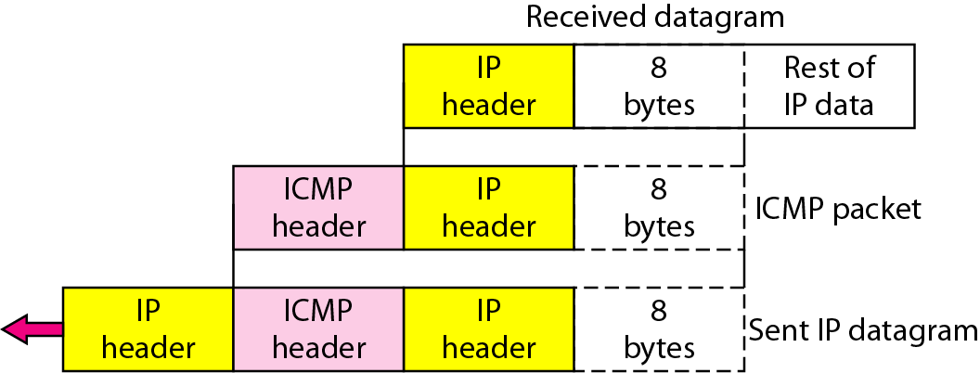
Figure 21.10 Contents of data field for the error messages
21.<number>

Slide 27
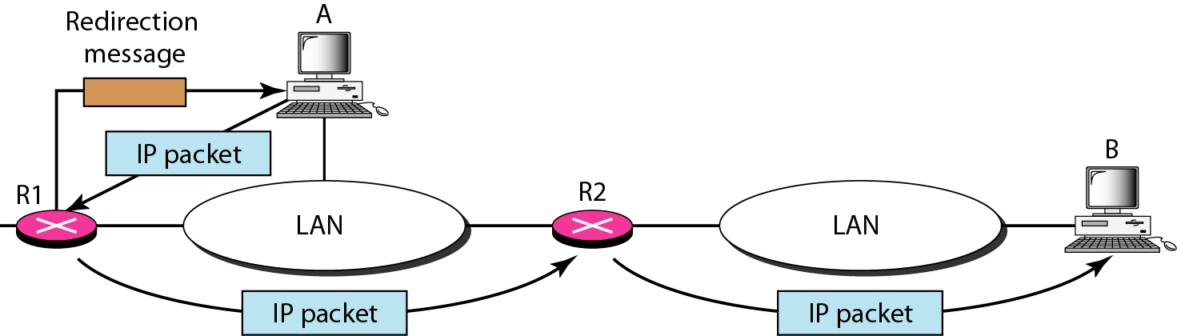
Figure 21.11 Redirection concept
21.<number>

Slide 28

Figure 21.12 Query messages
21.<number>

Slide 29
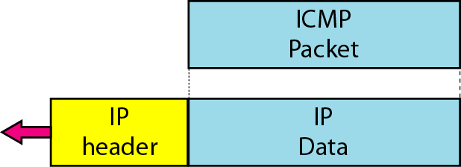
Figure 21.13 Encapsulation of ICMP query messages
21.<number>

Slide 30
Query Messages
Echo request reply: To identify the working of all routers and destination. (Ping)
Timestamp request reply: To synchronize the clock or to find round trip time
Address mask request reply: to know address mask like /24. The host request to router. Unicast or broadcast
Router solicitation and advertisement: Host can request for router information. Router advertises information about all the router it knows.
21.<number>

Slide 31
Example 21.2
Figure 21.14 shows an example of checksum calculation for a simple echo-request message. We randomly chose the identifier to be 1 and the sequence number to be 9. The message is divided into 16-bit (2-byte) words. The words are added and the sum is complemented. Now the sender can put this value in the checksum field.
21.<number>

Slide 32
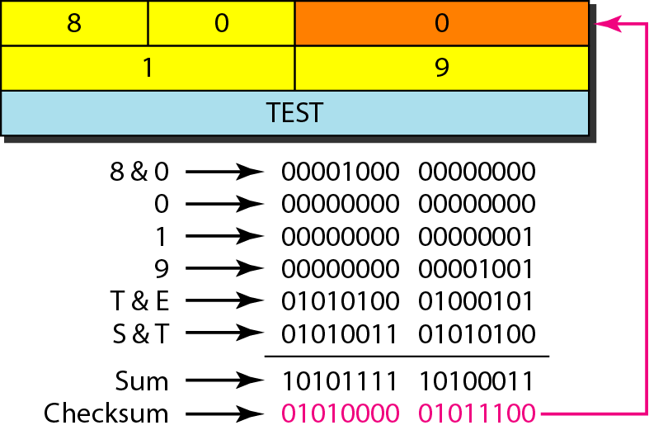
Figure 21.14 Example of checksum calculation
21.<number>

Slide 33
Example 21.3
We use the ping program to test the server fhda.edu. The result is shown on the next slide. The ping program sends messages with sequence numbers starting from 0. For each probe it gives us the RTT time. The TTL (time to live) field in the IP datagram that encapsulates an ICMP
message has been set to 62. At the beginning, ping defines the number of data bytes as 56 and the total number of bytes as 84. It is obvious that if we add 8 bytes of ICMP header and 20 bytes of IP header to 56, the result is 84. However, note that in each probe ping defines the number of bytes as 64. This is the total number of bytes in the ICMP packet (56 + 8).
21.<number>

Slide 34
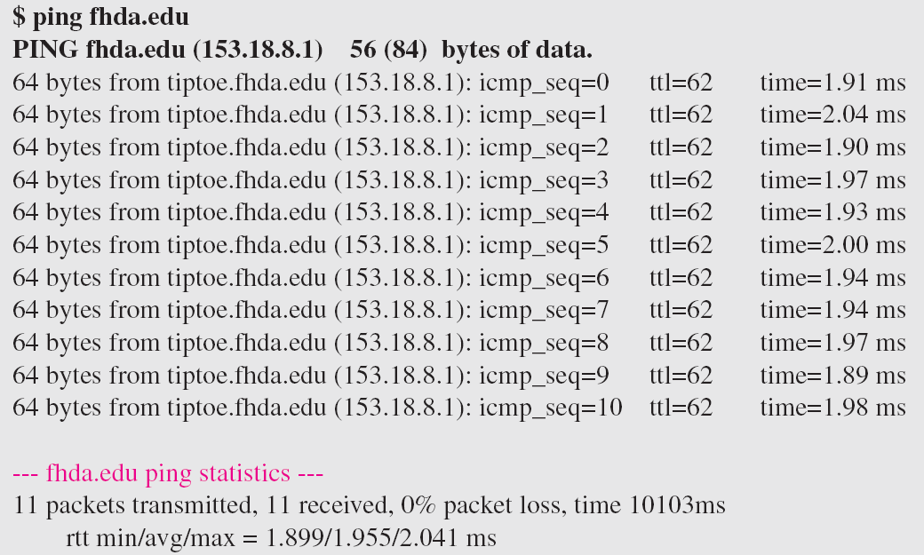
Example 21.3 (continued)
21.<number>

Slide 35
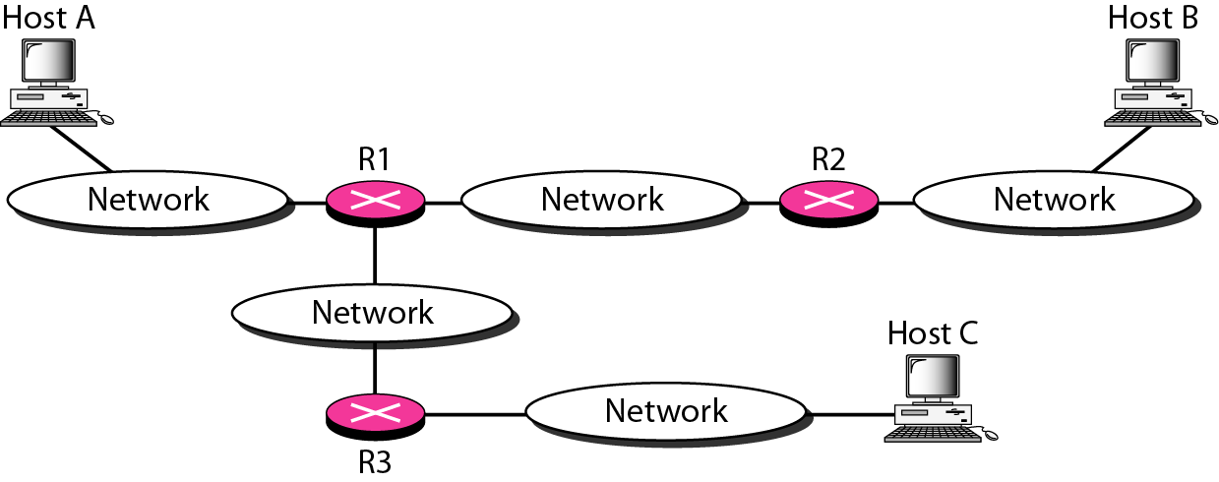
Figure 21.15 The traceroute program operation
21.<number>

Slide 36
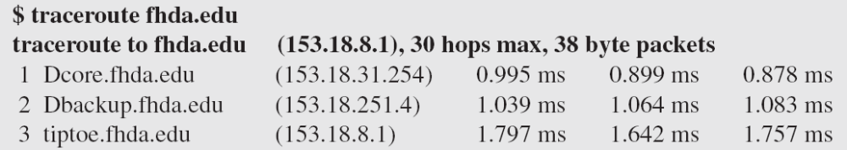
Example 21.4
We use the traceroute program to find the route from the computer voyager.deanza.edu to the server fhda.edu. The following shows the result:
The unnumbered line after the command shows that the destination is 153.18.8.1. The packet contains 38 bytes: 20 bytes of IP header, 8 bytes of UDP header, and 10 bytes of application data. The application data are used by traceroute to keep track of the packets.
21.<number>

Slide 37
Example 21.4 (continued)
The first line shows the first router visited. The router is named Dcore.fhda.edu with IP address 153.18.31.254. The first round-trip time was 0.995 ms, the second was 0.899 ms, and the third was 0.878 ms. The second line shows the second router visited. The router is named Dbackup.fhda.edu with IP address 153.18.251.4. The three round-trip times are also shown. The third line shows the destination host. We know that this is the destination host because there are no more lines. The destination host is the server fhda.edu, but it is named tiptoe.fhda.edu with the IP address 153.18.8.1. The three round-trip times are also shown.
21.<number>

Slide 38
Example 21.5
In this example, we trace a longer route, the route to xerox.com (see next slide). Here there are 17 hops between source and destination. Note that some round-trip times look unusual. It could be that a router was too busy to process the packet immediately.
21.<number>

Slide 39
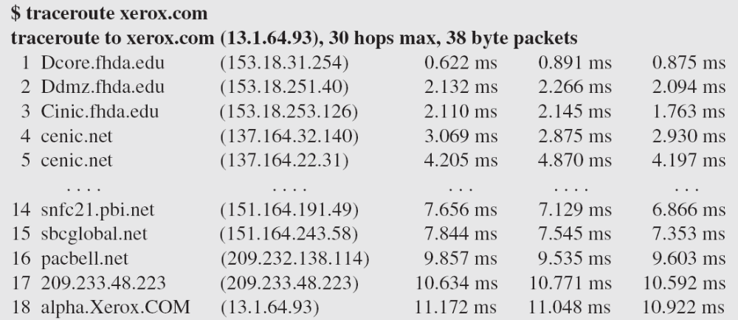
Example 21.5 (continued)
21.<number>

Slide 40
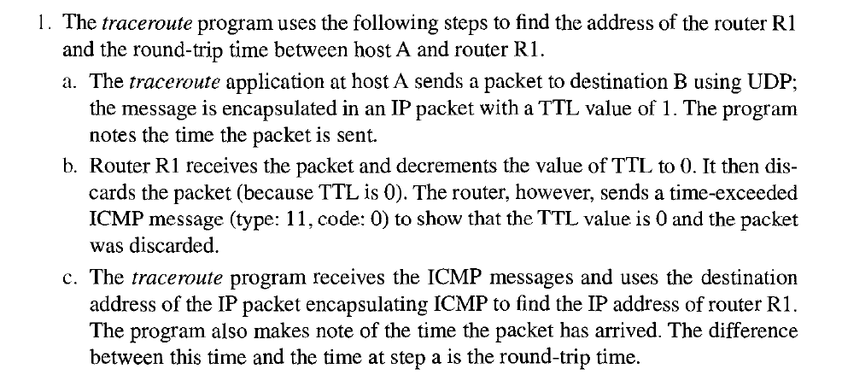
21.<number>

Slide 41
Trace route
Trace route step a to c is repeated 3 times to find the best round trip time.
Then the packet is sent with TTL 2 for finding next router. The second router also sends ICMP packet. The process continues.
When the receiver receives the packet, and since it does not find any application for the packet, it replies with ICMP , destination unreachable. When sender receives it, it stops traceroute.
21.<number>

Slide 42
21-3 IGMP
The IP protocol can be involved in two types of communication: unicasting and multicasting. The Internet Group Management Protocol (IGMP) is one of the necessary, but not sufficient, protocols that is involved in multicasting. IGMP is a companion to the IP protocol.
Topics discussed in this section:
Group Management
IGMP Messages and IGMP Operation
Encapsulation
Netstat Utility
21.<number>

Slide 43
IGMP
It is not a muticasting routing protocol.
It is a protocol that manages group membership.
A host or multicast router can have membership in a group.
If n numbers of multicast routers are connected to a network, their lists of group ids are mutually exclusive.
IGMP membership report is twice. If the first one is lost, second one can manage.
21.<number>

Slide 44
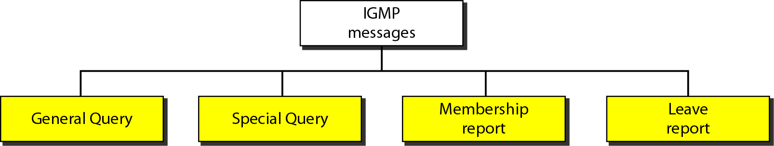
Figure 21.16 IGMP message types
21.<number>

Slide 45
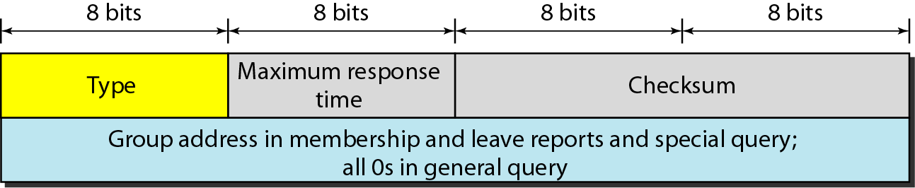
Figure 21.17 IGMP message format
Type: General, special, membership report, leave report
Maximum response time: Amount of time in which query must be answered. It is mentioned in tenths of seconds. Eg 100 -> 10sec
Checksum: calculated over 8 byte message.
Group address: Zero for general report. Group id in case of other reports
21.<number>

Slide 46
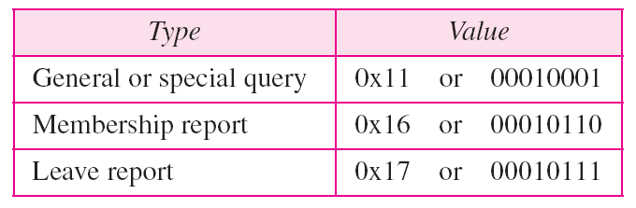
Table 21.1 IGMP type field
21.<number>

Slide 47
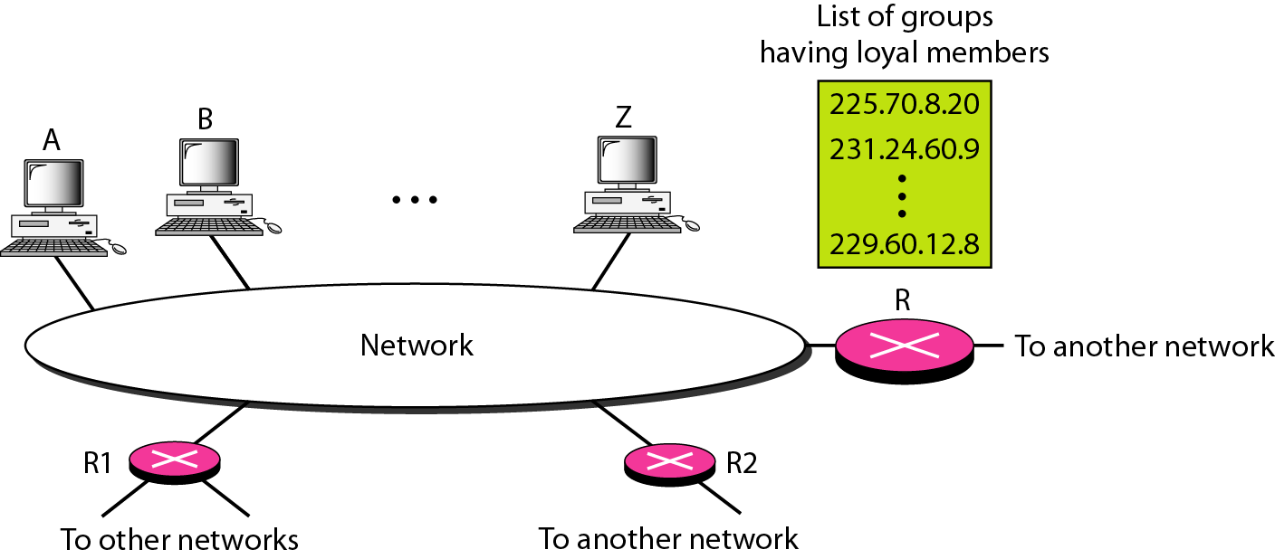
Figure 21.18 IGMP operation
21.<number>

Slide 48
Note
In IGMP, a membership report is sent twice, one after the other.
21.<number>

Slide 49
Note
The general query message does not define a particular group.
21.<number>

Slide 50
Joining and leaving group
Joining the group:
  A process request host fro joining a group. If this the new group, then host sends membership report message.
Leaving a group:
  If a host or router identifies no interest in a group, it sends leave report.
  When a multicast router receives a leave report, it checks whether any other host is interested in the group by sending special report. If no interest, then removes entry from list.
21.<number>

Slide 51
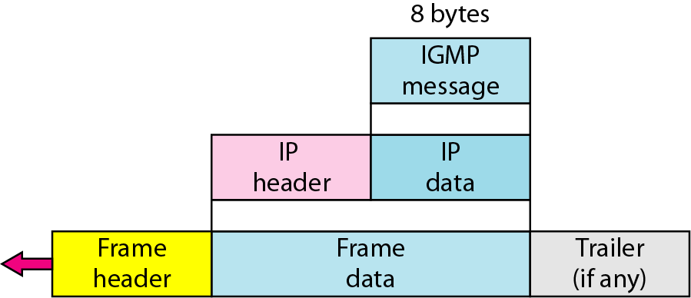
Figure 21.20 Encapsulation of IGMP packet
21.<number>

Slide 52
Note
The IP packet that carries an IGMP packet has a value of 1 in its TTL field.
21.<number>

Slide 53
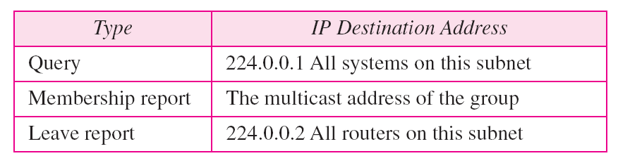
Table 21.2 Destination IP addresses
21.<number>

Slide 54
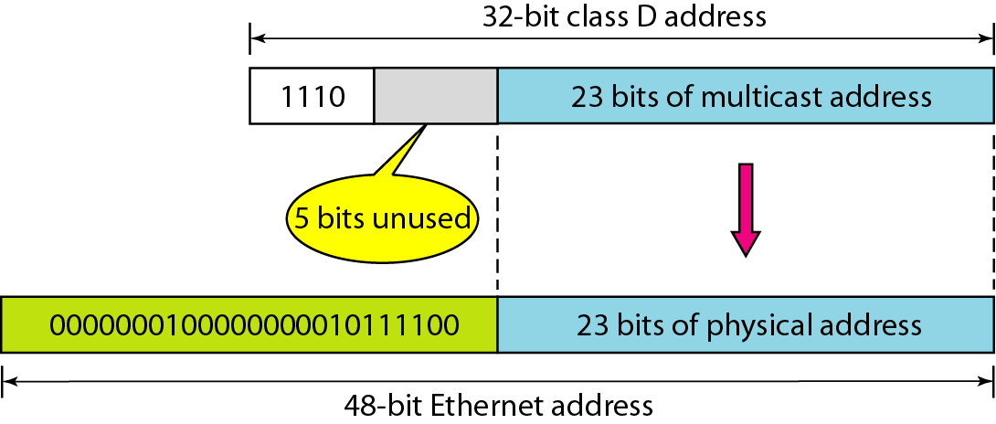
Figure 21.21 Mapping class D to Ethernet physical address
21.<number>

Slide 55
Note
An Ethernet multicast physical address is in the range
01:00:5E:00:00:00 to 01:00:5E:7F:FF:FF.
21.<number>

Slide 56
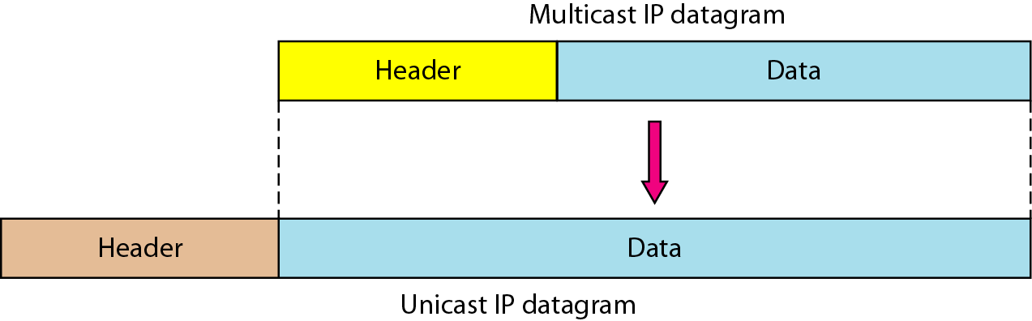
Figure 21.22 Tunneling
21.<number>

Slide 57
THANK YOU
21.<number>

